Slide 1

Cross-Selling Recommendations
Group Name: Solo Analyst
Name: Munirah Alfehaid
Email:munirah9hamad@gmail.com
Country: Saudi Arabia
Specialization: Data Analyst

Slide 2
Introduction
Client:
XYZ credit union in Latin America is performing very well in selling the Banking products (eg: Credit card, deposit account, retirement account, safe deposit box etc) but their existing customer is not not buying more than 1 product which means bank is not performing good in cross selling (Bank is not able to sell their other offerings to existing customer). XYZ Credit Union decided to approach ABC analytics to solve their problem.
Objective:
The objective of my work on this project was to analyze customer data and transform it into actionable insights that enable decision-makers at XYZ Credit Union to make data-driven decisions. By focusing on clear data analysis, cleaning, and visualization, my goal was to simplify complex information, presenting it in an intuitive dashboard that highlights key performance indicators (KPIs) to support informed decision-making

Slide 3
Data Collection

Slide 4
Cross Selling data
Total number of observations | 929615
Total number of files | 1
Total number of features | 24
Base format of the file | csv
Size of the data | 110.3 MB

Slide 5
Data Cleansing and Transformation

Slide 6
Categorical Data Imputation:
For the categorical column sexo, which contains missing values, the most frequent value (mode) was used to fill in the missing entries. This is a common practice for categorical variables where the most frequent category is assumed to be the best replacement for missing values.
Numeric Data Imputation:
For the numeric column cod_prov, which had missing values, the median of the column was used to fill in the missing entries. The median is preferred over the mean because it is less affected by outliers, providing a more robust central tendency measure.
KNN Imputation for Numeric Columns:
To handle missing values in other numeric columns, the K-Nearest Neighbors (KNN) imputation method was applied. This method imputes missing values by finding the nearest neighbors (in terms of other features) and averaging their values. This technique is useful for capturing the underlying structure in the data.
Handling Non-Numeric Columns Separately:For non-numeric columns that were not suitable for KNN imputation, the mode was used to fill in the missing values. This ensured that categorical data were treated appropriately, maintaining the integrity of the dataset.

Slide 7

EDA Analysis

Slide 8
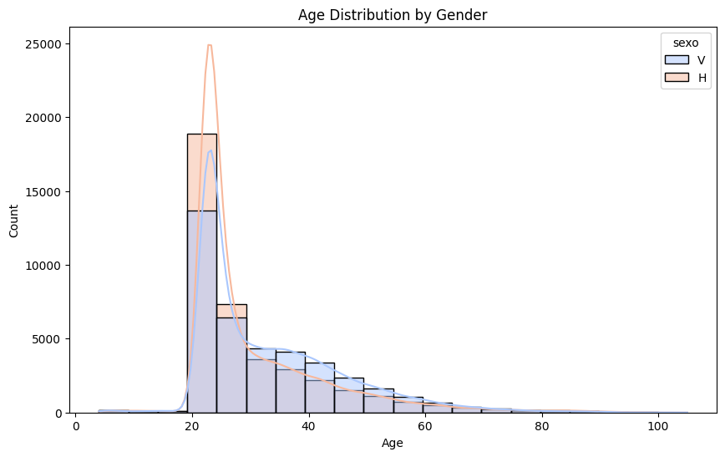
Customer Age and Gender
Most customers fall in the 20 to 40-year-old range, with a sharp peak around the 25-30 age group.
There are more male customers in this age range than females, as seen by the taller blue bars.
The chart shows that as age increases, the number of customers decreases for both genders.
There are outliers beyond 100 years of age, but they are very few.
This visualization suggests that the bank’s customer base is concentrated in the younger population (20-40), which could be important in understanding customer behavior and how to market different products for cross-selling.

Slide 9
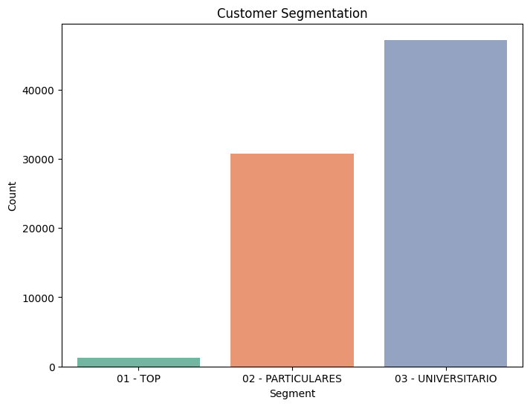
Customer Segmentation
PARTICULARES: The majority of the customers fall into this segment, indicating that regular banking services are the most commonly used among the bank's clients.
UNIVERSITARIO: This group is also substantial, suggesting the bank has a significant number of young or student customers.
TOP: This segment is quite small, meaning that there are relatively few high-value or priority customers.
This distribution is useful for tailoring marketing strategies and cross-selling products based on segment size and customer needs.

Slide 10
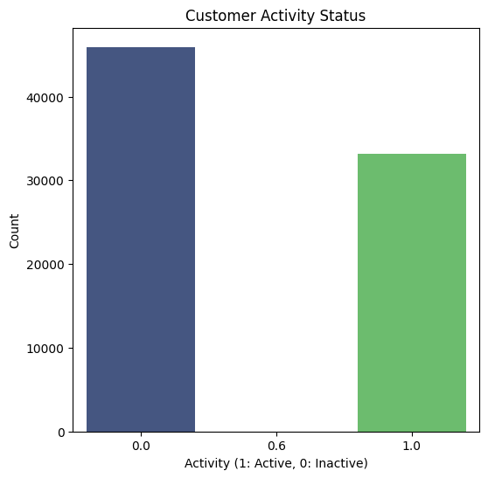
Customer Activity
Inactive Customers (0.0): There are more inactive customers than active ones, with over 500,000 customers in this category. This could suggest that a large portion of the bank’s customers are no longer using its products or services.
Active Customers (1.0): Although fewer in number compared to inactive customers, a substantial number (over 400,000) are still actively engaging with the bank.
This information could be valuable for designing re-engagement strategies aimed at converting inactive customers into active ones, such as offering promotions or customized products to encourage more interactions with the bank.

Slide 11
Dashboard

Slide 12
I designed this dashboard with a focus on visualizing the key performance indicators (KPIs) that are critical to understanding customer segmentation and activity patterns. I used Figma for the initial design, which helped me focus on the overall structure and presentation before implementing it in Power BI for interactivity and deeper data insights.

Slide 13
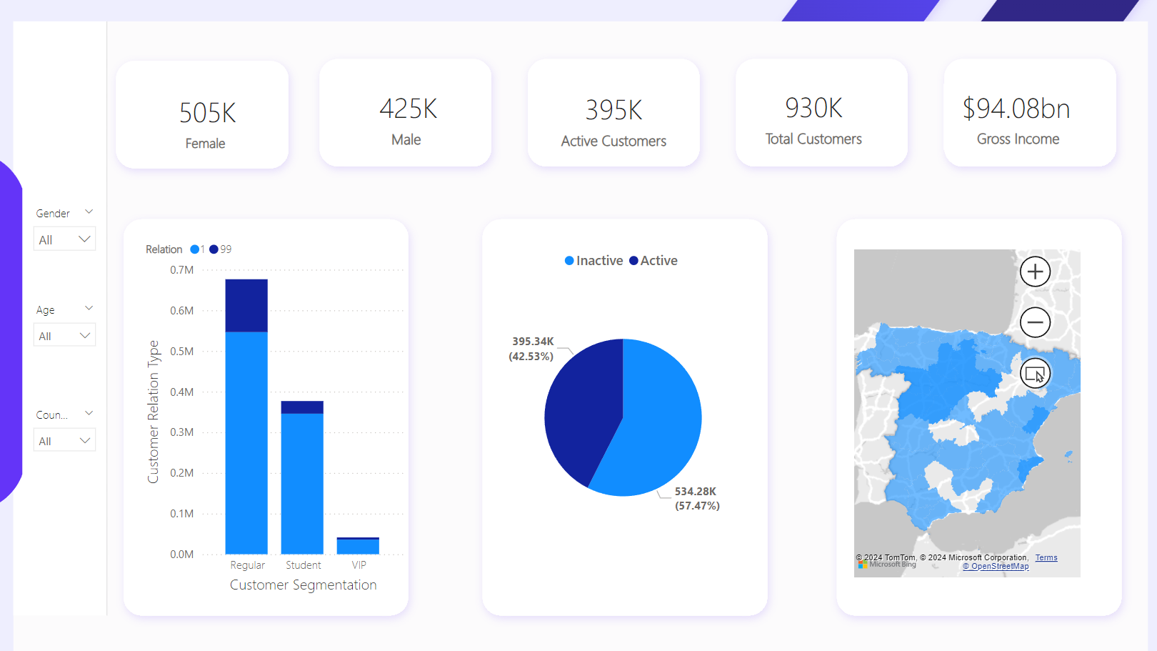

Slide 14
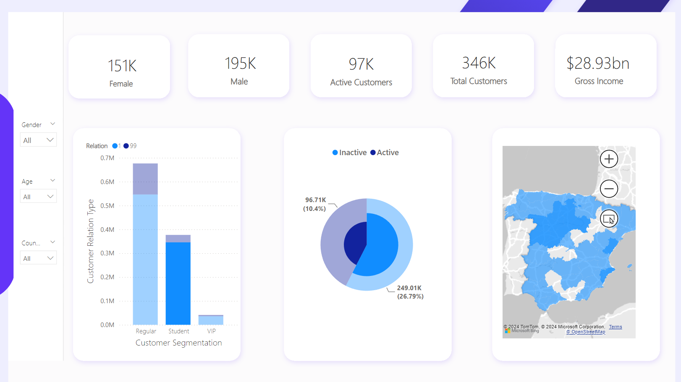
Showing interactivity

Slide 15
Key Performance Indicators (KPIs)
Female Customers: 505K
Male Customers: 425K
Active Customers: 395K
Total Customers: 930K
Gross Income: $94.08bn
Dashboard Overview
The dashboard provides an intuitive view of:
Customer Segmentation: This bar chart shows the distribution of customer types (Regular, Student, VIP) segmented by active and inactive customers.
Customer Activity: The pie chart visualizes the percentage of active vs inactive customers, giving a quick glance at the customer engagement.
Geographical Distribution: The map on the right highlights the spread of customers by region, providing insights into where most of the customer base is located.
Interactivity
The dashboard is fully interactive, allowing users to filter data dynamically using the slicers on the left:
Gender: Users can filter data based on gender.
Age: Allows slicing the data to see customer segmentation and activity patterns by age.
Country: Filters customers based on their country of residence.
Each slicer dynamically updates the KPIs and visualizations, enabling a comprehensive and user-friendly exploration of the dataset. By interacting with these slicers, you can observe changes in customer activity and gross income, providing insights to optimize cross-selling strategies.

Slide 16
Recommendation
Target inactive customers to engage them.
Focus on segments like VIPs or individuals with high income who may be more likely to buy additional products.
Design specific campaigns for underrepresented segments.

Slide 17
Conclusion
This dashboard not only captures the KPIs effectively but also allows for dynamic data exploration, making it a powerful tool for visualizing customer segmentation and activity in real time. The interactivity and design allow users to drill down into specifics and make data-driven decisions.

